Slide 1

Section 2.4 Average Rate of Change of a Function
Lecture 1
AROC Idea
Paradox in the beyond
Notes:
Super short section, just need idea

Slide 2

Section 2.4 Homework Submission to Canvas
Preview of section
Skim the section in text and write a short paragraph summary.
Give a bulleted list of all important definitions, theorems, and formulas without details.
Notes on video lectures
Take notes on everything written on slides including all details, worked examples, on-own activities, as well as your own thoughts and questions.
Try on-own activities first, then write down provided solution next to it for comparison.
Worked examples from the text
Write down the problem and attempt without looking at the solution.
Use the solution to write the best explanation you can.
Solutions to textbook exercises
Model approaches and explanations given in the video lectures and textbook examples.
Final reflection of section
List the key takeaways to remember as a bulleted list.

Slide 3
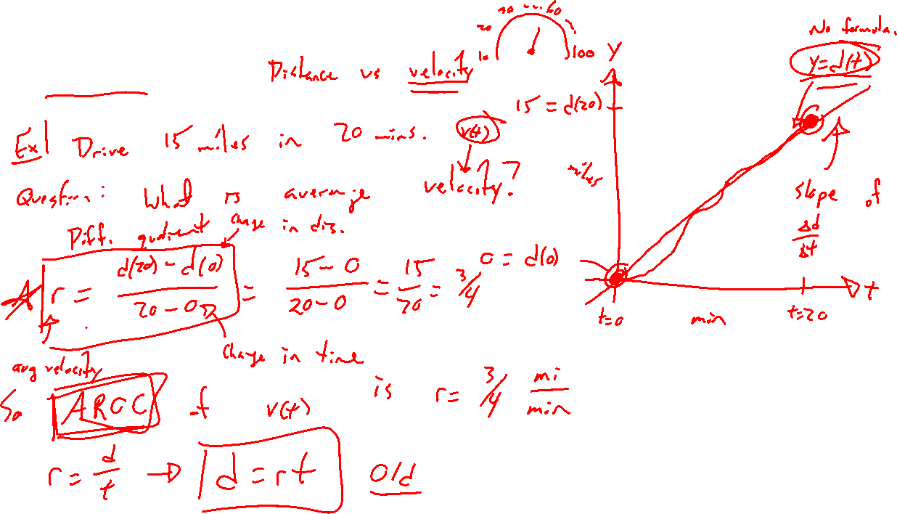
AROC Idea
Notes:
Dis = rate (time)
What is the average velocity (v(t), change in distance) if I go 20 miles in 15 mins? Note, we don’t know a formula for v for all t.
General formula, 2 forms.
Also called difference quotient.
Distinguish between net change.

Slide 4
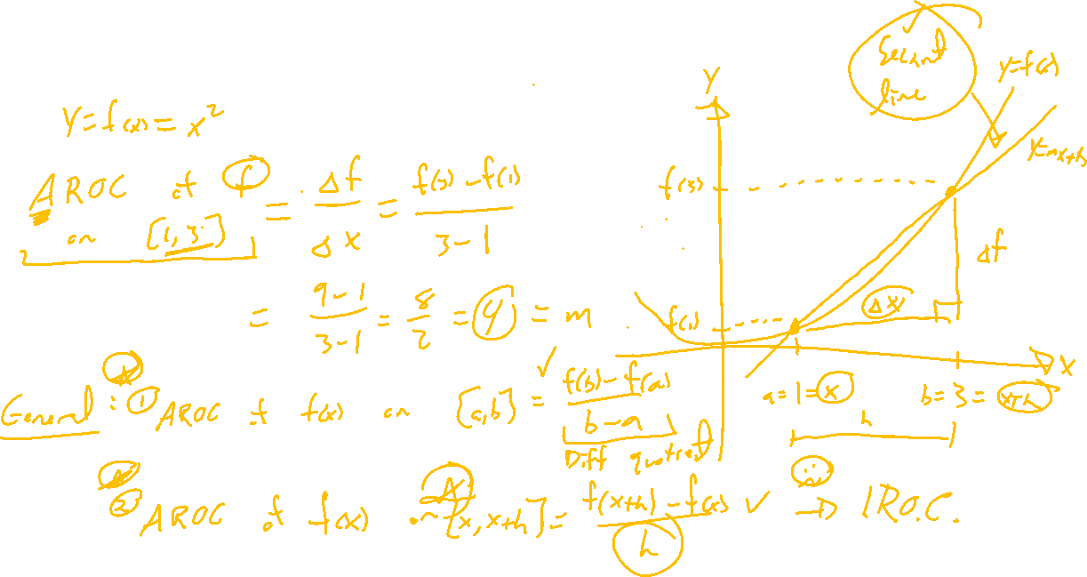
Ex: AROC and Function Graphs
Notes:
F(x) = x^2, AROC on [1,3]. Slope of secant line.
General case f(x), 2 forms.

Slide 5
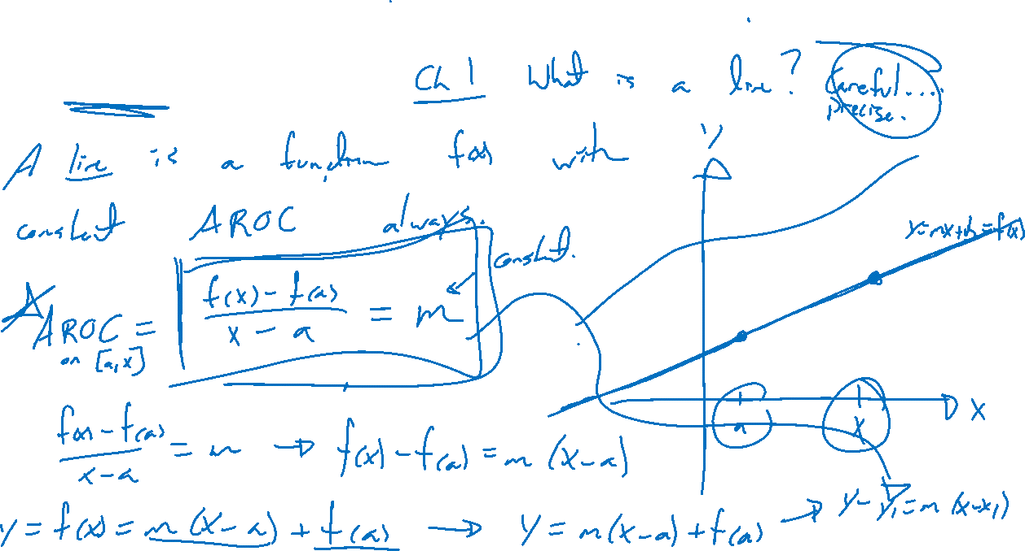
Lines Redefined
Notes:
Line y=f(x) = mx+b is the function such that AROC is always constant.
F(b)-f(a)/b-a = …. = m for any a,b

Slide 6
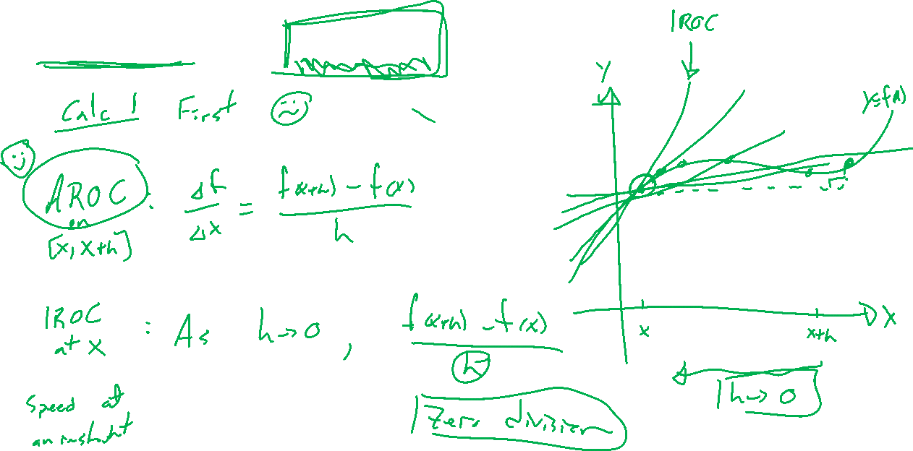
Calculus: The Paradox of AROC
Notes:
First problem of calculus considers AROC approaching IROC. Secant lines approaching tangent lines.
Need a way around zero division. Invention of idea of limit is the key.
Desmos tangent and secant line
https://en.wikipedia.org/wiki/Rate_(mathematics)#Rate_of_change
3blue1brown the essence of calculus

Slide 7

Section 2.4: Textbook Examples and Exercises
Rework examples 1, 2, 3, 4 in the text. Steps:
Write down a problem.
Close the book and attempt on own.
Check / correct your solution against the text solution.
If needed, rewrite the problem to be of the quality of the text solution.
Complete exercises 15, 19, 25, 27, 37
Write solutions of the same quality as in lecture and text solutions.
Check your solution against the answer in the back of the book.

Slide 8

Section 2.4 Homework Submission to Canvas
Preview of section
Skim the section in text and write a short paragraph summary.
Give a bulleted list of all important definitions, theorems, and formulas without details.
Notes on video lectures
Take notes on everything written on slides including all details, worked examples, on-own activities, as well as your own thoughts and questions.
Try on-own activities first, then write down provided solution next to it for comparison.
Worked examples from the text
Write down the problem and attempt without looking at the solution.
Use the solution to write the best explanation you can.
Solutions to textbook exercises
Model approaches and explanations given in the video lectures and textbook examples.
Final reflection of section
List the key takeaways to remember as a bulleted list.

